Slide 1
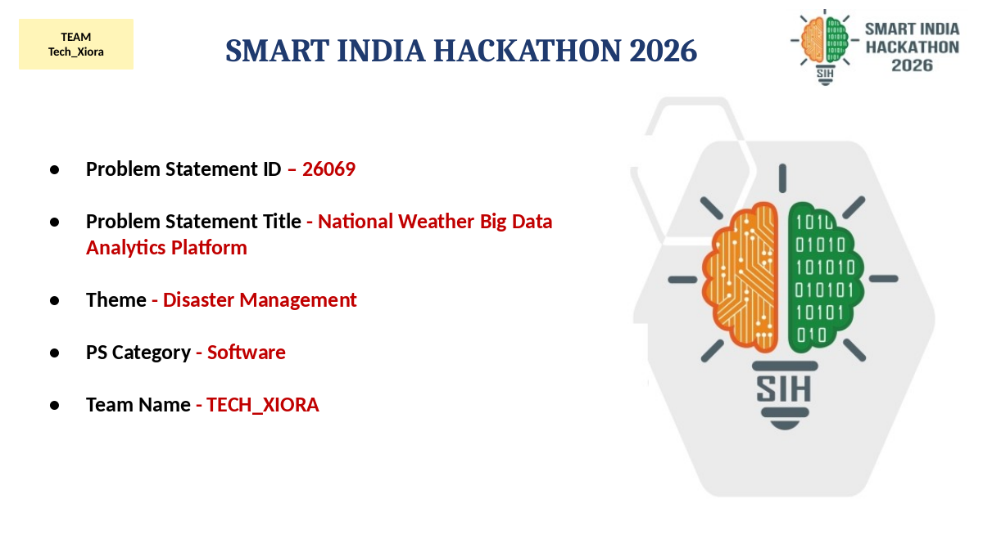

Slide 2
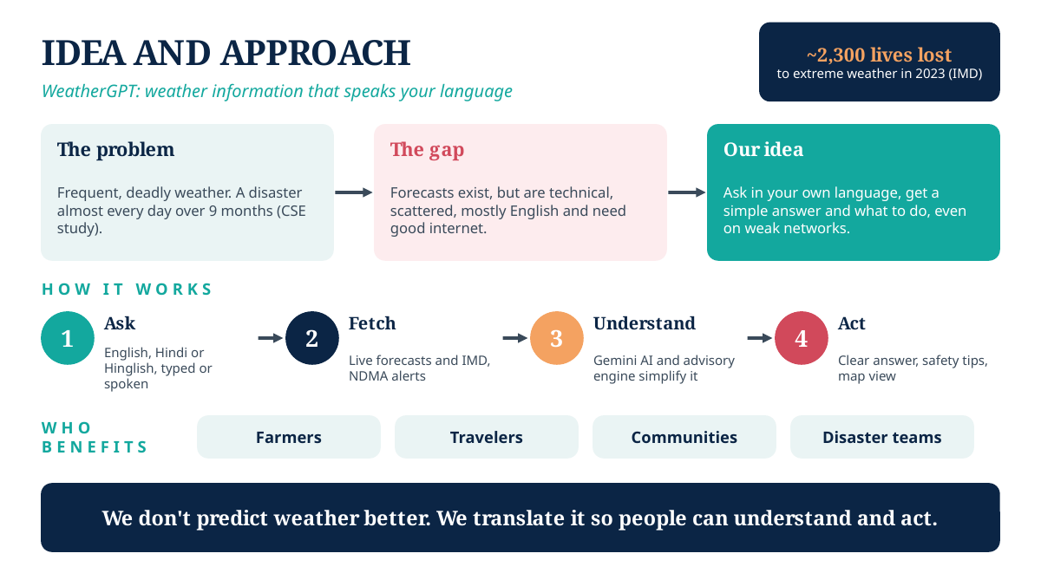
TEAM Tech_Xiora

Slide 3
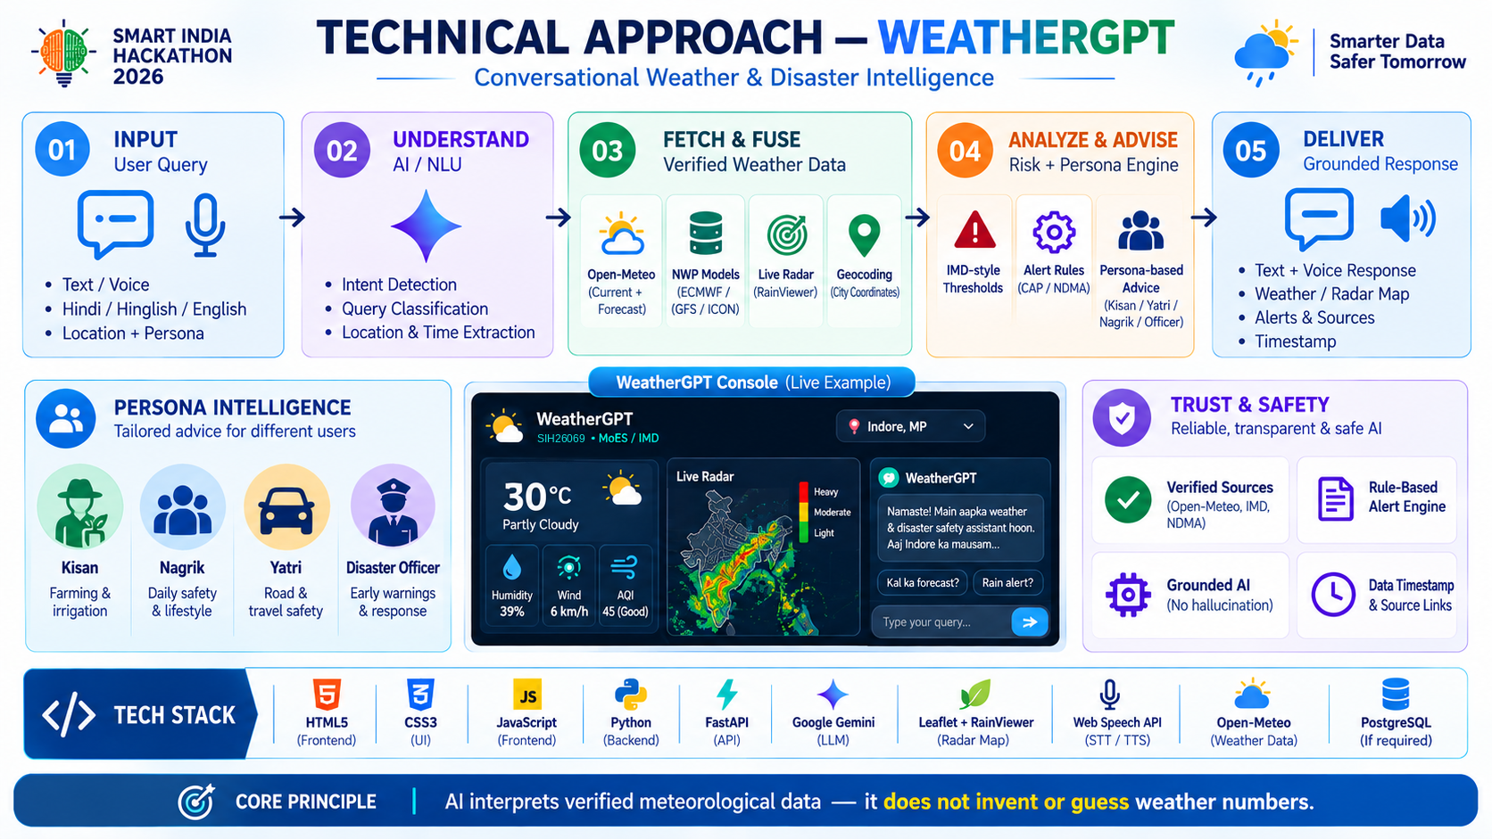
TEAM Tech_Xiora

Slide 4
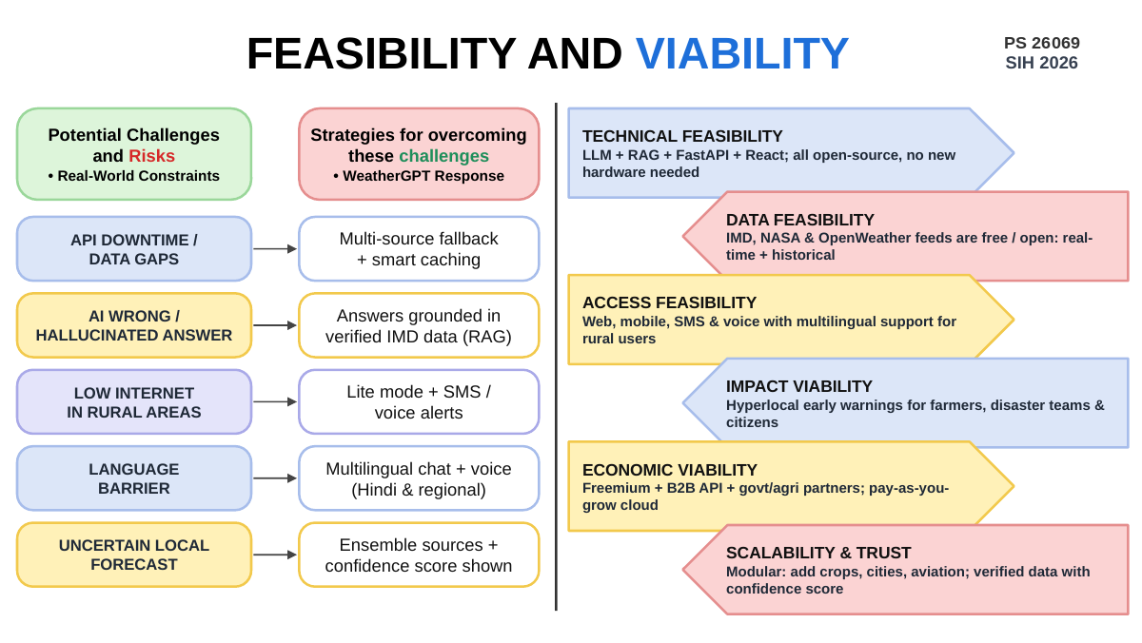
TEAM Tech_Xiora

Slide 5
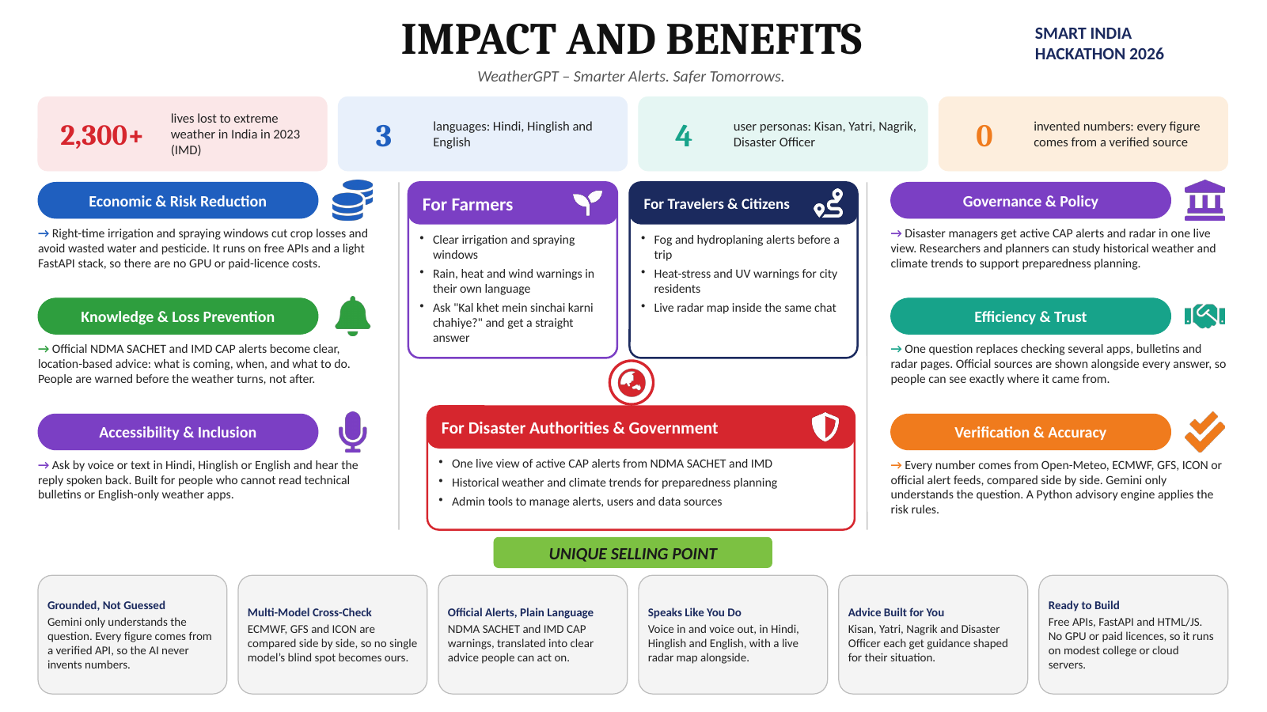
TEAM Tech_Xiora

Slide 6
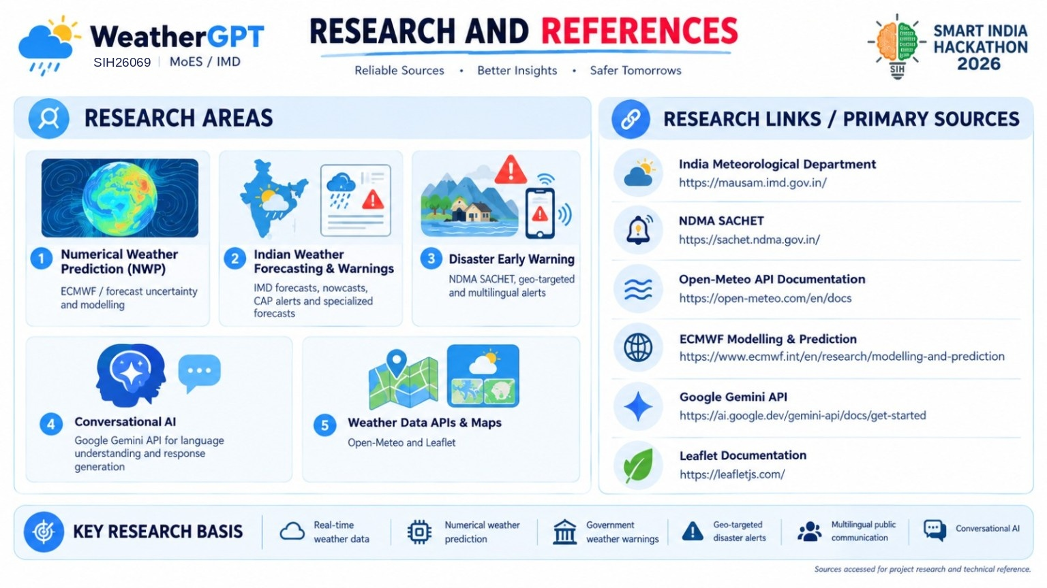
TEAM Tech_Xiora

